Slide 1
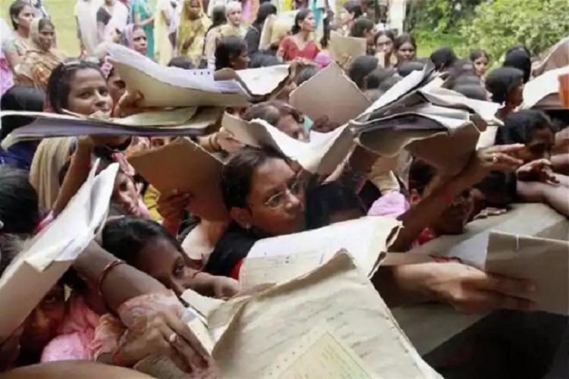
Team Name : Abstract
RURAL WOMEN UNEMPLOYMENT
Anjali Soni
Prince Srivastava
Harshita Raj
Meghna Sharma
Babitha Lakshmi Sai

Slide 2

Problem Statement :
To provide a platform to the rural women to earn their livelihood by selling their handmade products. This is to enhance their livinghood and ensure a better life for the whole family by making them financially strong.

Slide 3
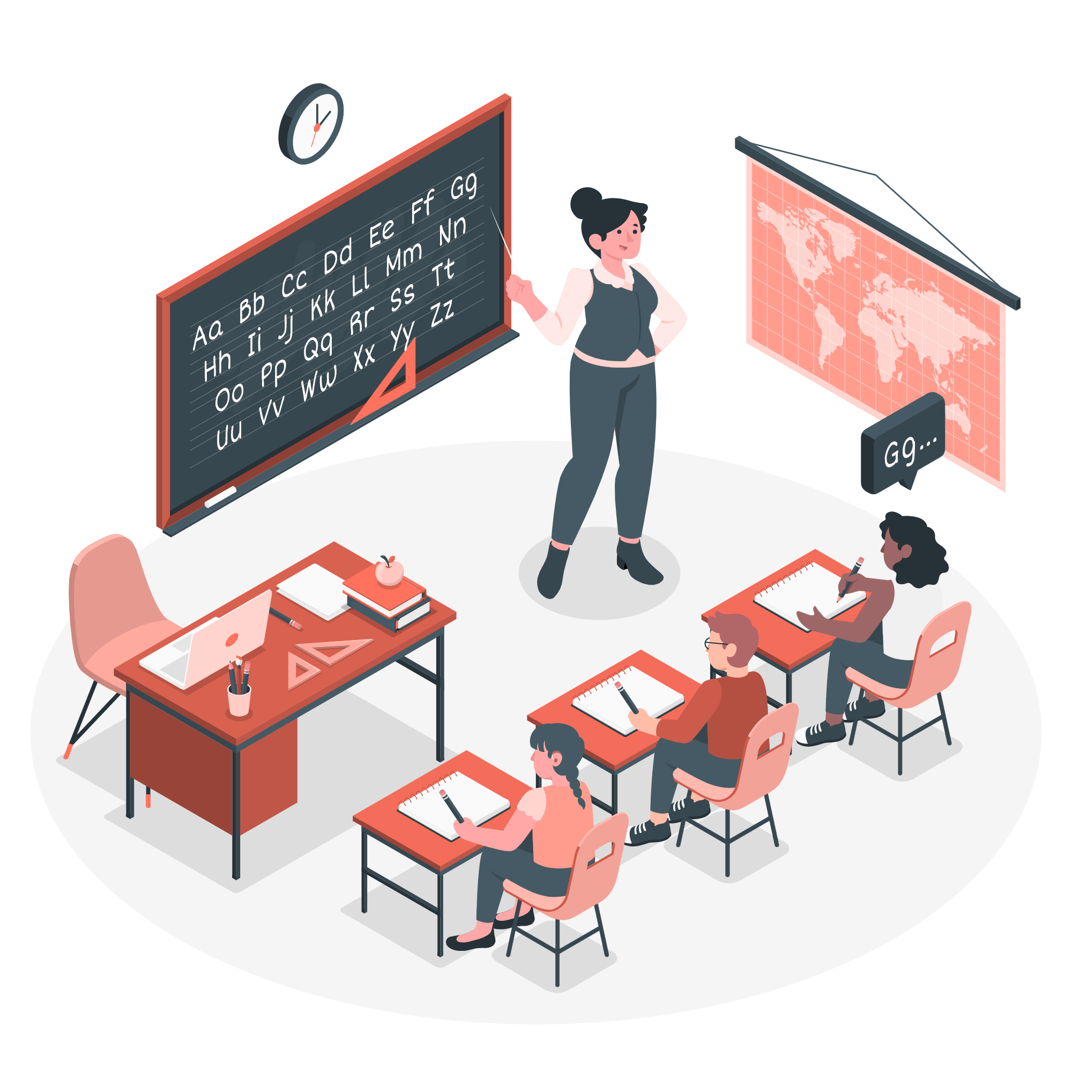
Problem Solution :
We are building a website where we will connect these rural women to the consumers directly without any intermediate traders. We will have a database of all those women who want to sell their product to the market, and then the consumers can directly connect to them, by locating their positions using the MAP APIs.

Slide 4

Demo Video of the Project

Slide 5

Tech Stacks Used :
React
TypeScript
HTML
SCSS

Slide 6

Our Approach :
Building a website to connect rural women to the big market.
Using the map APIs to track the location of those women.
Store the details of them in a structured database.

Slide 7

USP( Unique Selling Point) :
This will be a great initiative for the development of rural women in India.
They will be able to expand their business and thus their income.
There will be no intermediate traders so that will increase the profit.
As poverty and population in our country is high, this idea will be able to reach to large no. of people.

Slide 8

Prototype Video :

Slide 9

References Used :
https://www.bloombergquint.com/business/why-rural-women-are-falling-out-of-indias-workforce-at-faster-rates-than-urban-women
https://m.economictimes.com/jobs/unemployment-rate-among-indian-women-more-than-double-of-men-study/articleshow/70908166.cms
https://www.sciencedirect.com/science/article/abs/pii/0277539585900068
Github repo : https://github.com/pr-1/hack-4-women

Slide 10
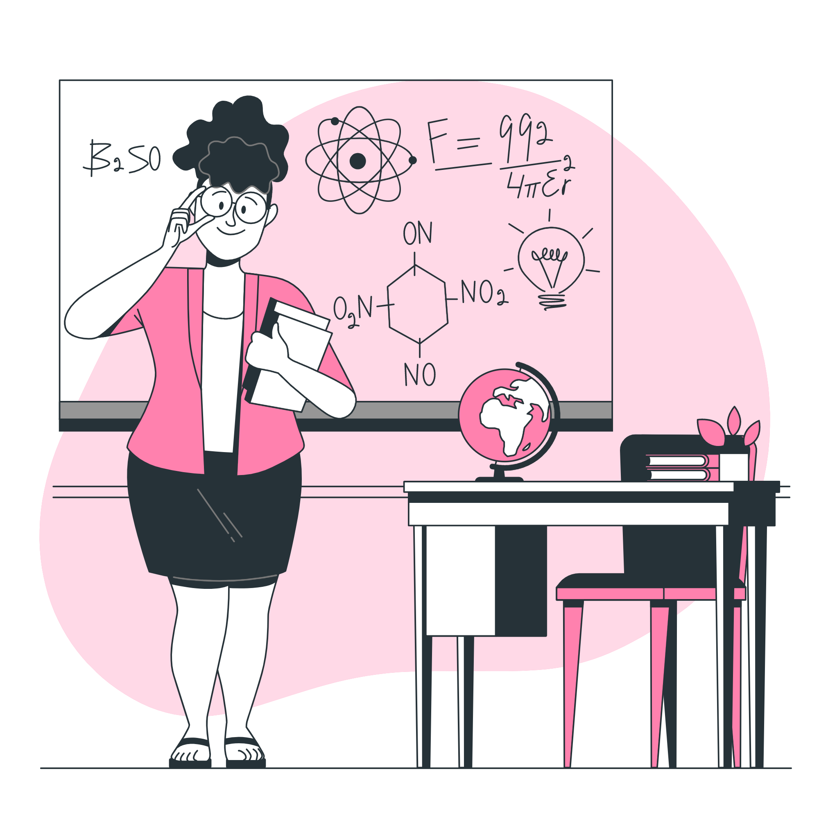
Future Scope :
ERGW(EMPLOYEES RESOURCE GROUP FOR WOMEN )
It has various employees from different industries and MNCs as a database .
OBJECTIVES :
Collection of job opportunities and publishing in website
qualification based categorization of jobs
conduction of skill and mentorship programs and webinars.
AMA(Ask Me Anything) box for various queries of women
Enhancement of rural groups by various programs
By 2030 , 30 percent improvement of women in employment will be achieved

